Slide 1
Structure of C Program, Character Set, Tokens

Slide 2
C Character set
Letters → ‘a’, ‘b’, ‘c’,………..’z’ Or ‘A’, ‘B’, ‘C’,……….’Z’
Digits → 0, 1, 2,……………………9
Special characters → ;, ?, >, <, &,{, }, [, ]……
White spaces → New line (\n), Tab(\t), Vertical Tab(\v) etc.
Character set is a set of valid characters that a language can recognize.
C character set consists of letters, digits, special characters, white spaces.

Slide 3
C Tokens
Tokens
Keywords
Operators
Strings
Constants
Special Symbols
Identifiers
Break
Int
float
Variable
Constant
Array name
Function name
+
*
%
“hello”
“123”
“s”
123
21.3
‘A’
‘g’
“hello”
;
?
>
&
{
A token is a group of characters that logically belong together.
The programmer writes a program by using tokens.
C uses the following types of tokens.
Notes:
In a passage of text, individual words and punctuation marks are called tokens.
Similarly in a C program the smallest individual units are known as tokens.

Slide 5
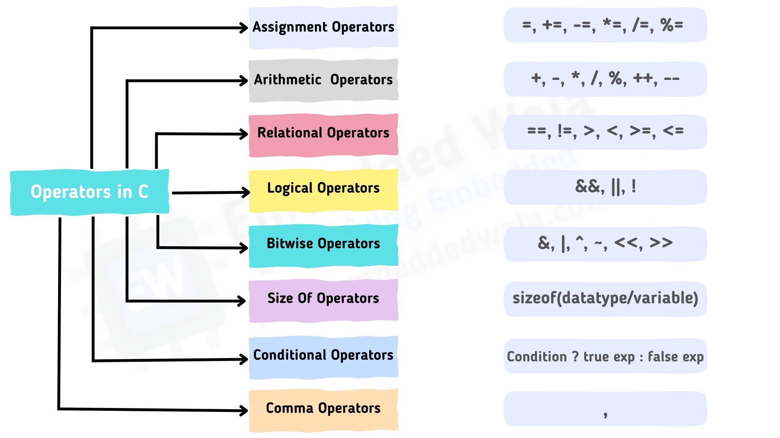

Slide 6
Simple C program

Slide 8
Hello world program

Slide 9
Structure of C program
#incude<stdio.h>
void main()
{
printf(“I love programming\n”); /*new line*/
printf(“You can learn it easily ”); /*add comment*/
printf(“easily\n”);
}

Slide 10
Input: Scanf()
#incude<stdio.h>
void main()
{
int num;
printf(“Enter a number = ”);
scanf(“%d”, &num);
printf(“The number is = %d”, num);
}
Scanf() is used to obtain the value from the user
It is included in stdio.h
Eg: scanf(“%d”, &integer1);
Notes:
Scanf is used to obtain the value from the user
The scanf function reads from the standard input, which is usually the keyboard.
Eg: Scanf(“%d”, &integer1);
This scanf has two arguments, "%d" and &integer1.
The first argument, the format control string, indicates the type of data that should be input by the user. The %d conversion specifier indicates that the data should be an integer
The second argument of scanf begins with an ampersand (&)—called the address operator in C— followed by the variable name. The ampersand, when combined with the variable name, tells scanf the location (or address) in memory at which the variable integer1 is stored.
When the computer executes the preceding scanf, it waits for the user to enter a value for variable

Slide 11
Data Types and its Storage Requirements and its Range
Format Specifier
%c
%c
%d
%u
%h
%hu
%ld
%lu
%f
%lf %Lf

Slide 12
Character Group | Meaning
%c | Read a single character
%d | Read a decimal integer
%f | Read a floating point number
%g | Read a short int number
%h | Read a short int number

Slide 13
C Program Essentials: Format Specifiers
Format specifier | Description
%d or %i | It is used to print the signed integer value where signed integer means that the variable can hold both positive and negative values.
%u | It is used to print the unsigned integer value where the unsigned integer means that the variable can hold only positive value.
%o | It is used to print the octal unsigned integer where octal integer value always starts with a 0 value.
%x | It is used to print the hexadecimal unsigned integer where the hexadecimal integer value always starts with a 0x value. In this, alphabetical characters are printed in small letters such as a, b, c, etc.
%X | It is used to print the hexadecimal unsigned integer, but %X prints the alphabetical characters in uppercase such as A, B, C, etc.
%f | It is used for printing the decimal floating-point values. By default, it prints the 6 values after '.'.

Slide 14
C Program Essentials: Format Specifiers
Format specifier | Description
%e or %E | It is used for scientific notation. It is also known as Mantissa or Exponent.
%g | It is used to print the decimal floating-point values, and it uses the fixed precision, i.e., the value after the decimal in input would be exactly the same as the value in the output.
%p | It is used to print the address in a hexadecimal form.
%c | It is used to print the unsigned character.
%s | It is used to print the strings.
%ld | It is used to print the long-signed integer value.

Slide 15
Output: Printf()
C provides the printf() to display the data on the monitor.
It is included in stdio.h
Examples are:
Printf(“programming is an art”;
Printf(“%d”, number);
Printf(“%f%f”, p,q);

Slide 16
Adding two integers
#include <stdio.h>
int main( void )
{
int sum; /* variable in which sum will be stored */
int integer1; /* first number to be input by user */
int integer2; /* second number to be input by user */
printf( "Enter first integer\n" );
scanf( "%d", &integer1 ); /* read an integer */
printf( "Enter second integer\n" );
scanf( "%d", &integer2 ); /* read an integer */
sum = integer1 + integer2; /* assign total to sum */
printf( "Sum is %d\n", sum ); /* print sum */
return 0; /* indicate that program ended successfully */
} /* end function main */

Slide 17
Syntax and Logical errors
Syntax errors: violation of programming language rules (grammar).
Detected by the compiler
Eg: printf (“hello world”) // semicolon missing
Logical errors: errors in meaning:
Programs are syntactically correct but don’t produce the expected output
User observes output of running program

Slide 18
C Compiler:
For Window, you need to install MinGW for GCC or you can use Turbo C compiler.
The most frequently used and free available compiler is the GNU C/C++ compiler for Linux
For MAC, the easiest way to obtain GCC is to download the Xcode development environment from Apple's web site and follow the simple installation instructions.
What to do when a C program produces different results in two different compilers? → Your program must follow C standard i.e. ISO/IEC 9899:2011 (also known as C11)
Notes:
The language standard leaves several degrees of freedom to the implementations. Firstly, even if the program is implemented correctly, its behavior might depend on implementation-defined language features. For example, different implementations can have different ranges for basic integer types.
Secondly, the program might simply be broken. A broken program in this context is a program that relies on behavior that is either undefined or unspecified by the language. This program will appear to "work" in some way, but its actual behavior will depend on unpredictable factors and, therefore, will be inconsistent.

Slide 19
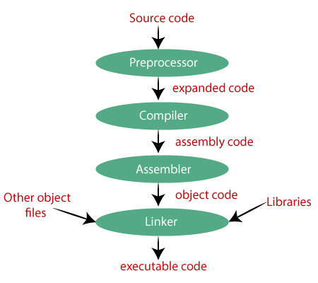
Compilation Process
The compilation is a process of converting the source code into object code.
The compilation process can be divided into four steps, i.e., Pre-processing, Compiling, Assembling, and Linking.
The extension of the object file in DOS is '.obj,' and in UNIX, the extension is 'o'.
Notes:
Preprocessor process the code that requires the compiler to understand
Compiler: creates the object code
Linker: Links the object code with libraries and create an executable file

Slide 20
Thank You!!

Slide 21
A program for Finding an Even and Odd
#include<stdio.h>
main()
{
int a,x;
printf("Enter a number\n");
scanf("%d",&a);
x=a%2;
if(x==0)
printf("Number a=%d is even\n",a);
else
printf("Number a=%d is odd\n",a);
}

Slide 22
Swap of Two Numbers, Using Two Variables
#include<stdio.h>
main()
{
int a=5, b=6;
printf("Swap of Numbers\n");
a=a+b; printf("a=%d\n",a);
b=a-b; printf("b=%d\n",b);
a=a-b; printf("a=%d\n",a);
///b=c;
printf("Final a=%d and b=%d",a,b);
}

Slide 23
Interest Calculation Program
#include<stdio.h>
#define PERIOD 10
#define PRINCIPAL 5000.00
void main()
{
int year;
float amount, value, Inrate;
amount=PRINCIPAL;
inrate=0.11;
year=0;
while(year<=PERIOD)
{
printf("year=%2d and amount=%8.2f\n",year, amount);
value=amount=amount+inrate*amount;
year=year+1;
amount=value;
}
}

Slide 24
Subroutine Call Program
#include<stdio.h>
main()
{
int a, b, c;
a=5; b=6;
c=mul(a,b);
printf("multplcaton of a=%d and b=%d is = %d",a,b,c);
}
int mul(int x,int y)
{
int p;
{
p=x*y;
return p;
}
}

Slide 25
Compilation Process Example

